Slide 1
Workshop in Info-Sec: Final Stage
מציג: תומר קטיעי

Slide 2
Part 1: IPS
Apache Superset
Session Cookies
Privilege Escalation
Remote Code Execution
Protection

Slide 3
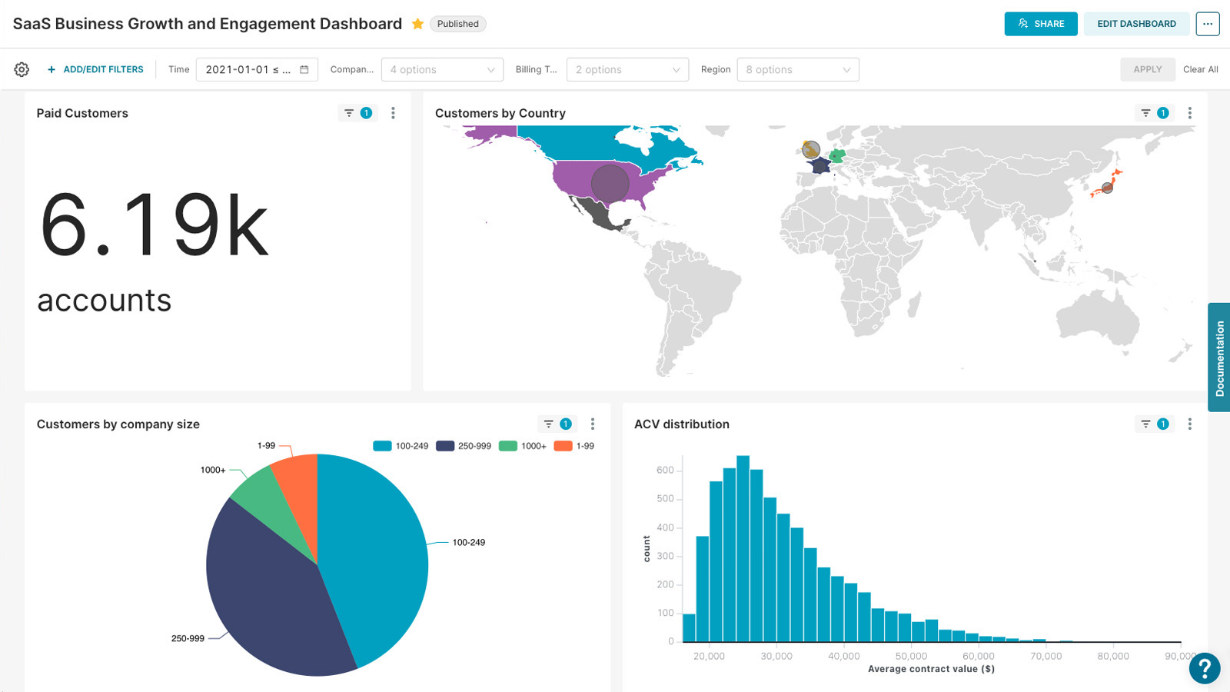
Apache Superset
“Apache Superset is a Data Visualization and Data Exploration Platform” github.com/apache/superset

Slide 4
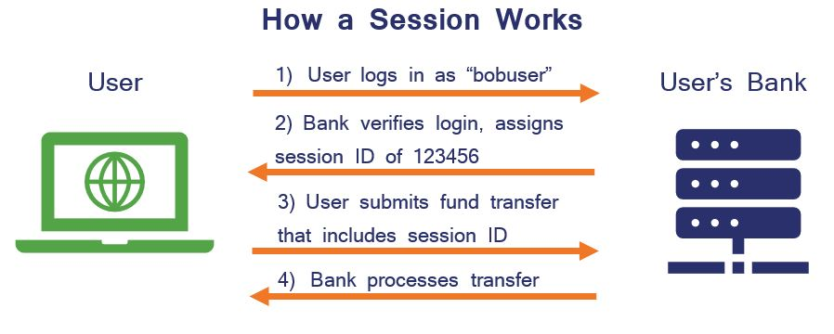
Session Cookies – Your Online ID

Slide 5
But what if we find someone else’s cookie?

Slide 6

Step 1: Privilege Escalation
Using an admin’s cookie, we can impersonate the admin user, and thus gain admin privileges.
How to find an admin’s cookie?
CVE-2023-27524, affecting Superset versions <=2.0, allows a known default key for signing session cookies.
Thus, given a regular user’s cookie, we can modify the cookie: change the user ID to an admin’s, and then resign the cookie.

Slide 7

Step 2: Mount Metadata Database
The previously-gained admin privileges allow the attacker to create a new database listing in the server.
CVE-2023-39265 allows setting that database to be the metadata database.
The metadata database contains essential metadata of the Superset server, such as user credentials and dashboard configurations.
The attacker then uses the built-in SQL interface to read user credentials from the metadata database and later also write malicious payload into it.

Slide 8

Step 3: Remote Code Execution
CVE-2023-37941 suggests that inserting a specifically crafted Python object into the metadata database can lead to remote code execution on the server.
The attacker does so by creating a dashboard and replacing its entry in the metadata database with a malicious “pickled” python payload.
The attacker then sends a GET request to that dashboard and the payload is triggered, causing the server to open a shell to the attacker – Victory!

Slide 9
How was it fixed?
The real-life solution was to force users into setting a random cookie-signing key, instead of the default one (versions >2.0 of Superset).
This solution prevents the first step of the attack, which was signing a fake cookie using the known default key.

Slide 10
My Solution – logging received cookies
The key feature of the attack was that the attacker could craft an admin cookie signature that he never really got from the server.
Thus, a possible solution is disabling the usage of non-received cookies. i.e. when the firewall intercepts a packet from a client that has a session cookie that was never sent by the server, it simply closes the connection.
Pro: no false-positives, all session cookies used by a regular client are originally received from the server, and so are recognized by the firewall.
Con: only solves this specific attack by treating CVE-2023-27524. If one still manages to gain admin privileges, he can exploit CVE-2023-39265 and CVE-2023-37941.

Slide 11

Other possible protections
We can block access to the metadata database, by filtering packets that contain the metadata database path.
Con: we might encounter this path in a non-malicious context.
We can drop suspicious payloads (like pickled data) sent to the server.
Con: hard to define.

Slide 12
Part 2: DLP
Decision Trees
Random forest
Detecting C code with a random forest
Gathering data

Slide 13
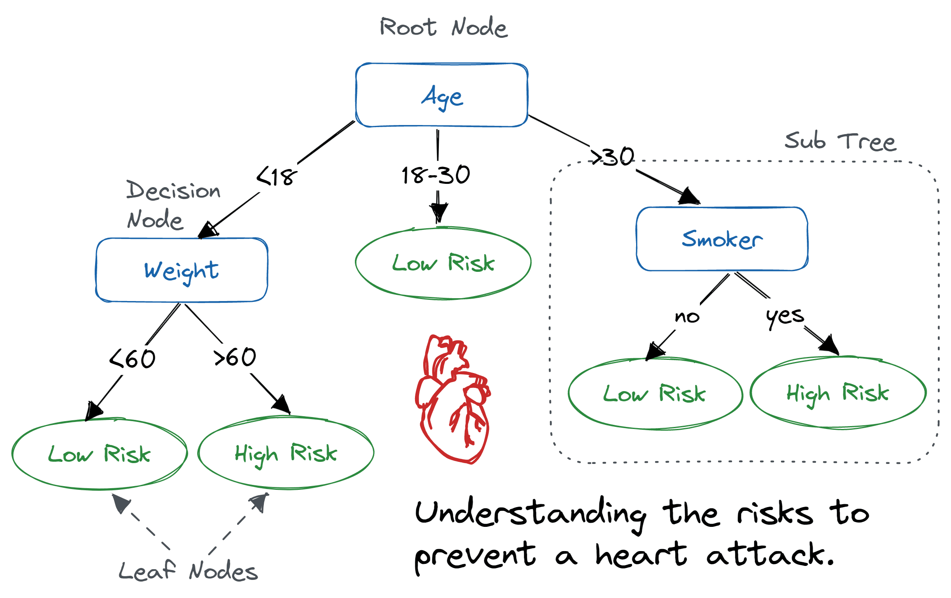
Decision Tree - example

Slide 14
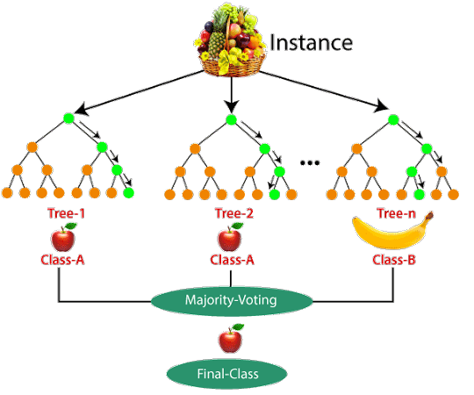
Random Forest

Slide 15
Detecting C code with Random Forest
Now we want to be able to distinguish between C code and regular text.
For now, say we have enough labeled data (both C code and regular text) to train a model on.
We can set the features of each sample to be frequencies of typical C phrases, keywords and symbols, for example: - if(…) { - #include … - ; || !=
After scanning the data (using regular expressions) and creating frequency vectors, we can use Python’s sklearn module for building a good Random Forest from the vectors.

Slide 16
Gathering Data
Data can be gathered from datasets available online.
I got my C code dataset from a dataset called “C programs” on kaggle.com
For regular text, I chose to use HTTP traffic samples which I recorded on my Firefox web browser.
In practical scenarios, this choice is wiser than using simple plain text because it prevents false-positives on common text formats like JSON.

Slide 17
Thank you for listening!
If you have any questions, please ask!

